Slide 1

Cloud computing
Guided by: shri.P.L.Halgekar (HOD Cse)
Name : Venkatesh sungar (389CS22056)
Darshan Kumbar (389CS22010)

Slide 2
What is cloud computing ?
As we know, cloud computing technology is used by both small and large organizations to store the information in cloud and access it from anywhere at any time using the internet connection.
Cloud computing architecture is a combination of service-oriented architecture and event-driven architecture.
Cloud computing architecture is divided into the following two parts –
Front End
Back End

Slide 3
Front End
The front end is used by the client. It contains client-side interfaces and applications that are required to access the cloud computing platforms. The front end includes web servers (including Chrome, Firefox, internet explorer, etc.), thin & fat clients, tablets, and mobile devices.
Back End
The back end is used by the service provider. It manages all the resources that are required to provide cloud computing services. It includes a huge amount of data storage, security mechanism, virtual machines, deploying models, servers, traffic control mechanisms, etc.

Slide 4
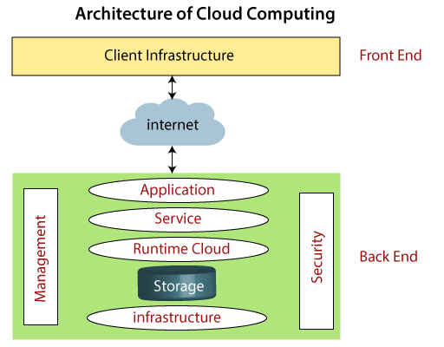

Slide 5
File Storage:
Cloud storage allows you to store and access files easily from any device with an internet connection. Services like Amazon S3, Dropbox, and OneDrive provide secure and scalable storage options.
Big Data Analytics:
Collecting and analyzing big data is crucial for business growth and problem-solving. Cloud computing provides the necessary computing resources for handling large datasets, enabling companies to discover insights and make informed decisions.
Data Backups and Archiving:
Cloud services offer reliable data backup and archiving solutions. You can securely store historical data, ensuring business continuity and compliance with data retention policies.
Disaster Recovery:
Cloud-based disaster recovery solutions allow organizations to quickly restore data and applications after unexpected events. The cloud’s scalability ensures efficient recovery processes.
Software Testing and Development:
Developers use cloud services to build and test custom applications. Cloud platforms like AWS and Google Cloud provide development environments, reducing infrastructure costs and speeding up development cycles².

